Slide 1

United Way
Born Learning Academy
Session 6

Slide 2
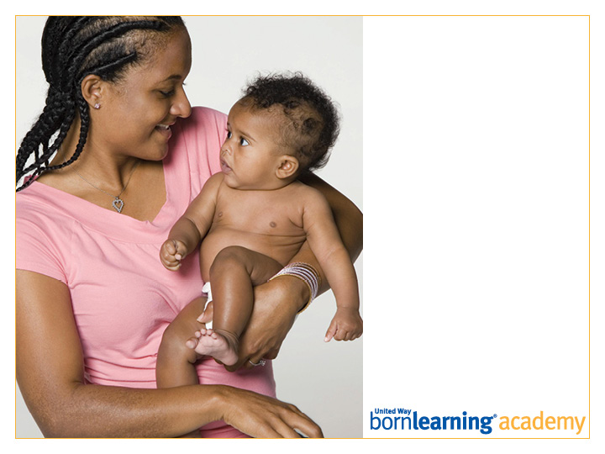
Pre-Test

Slide 3
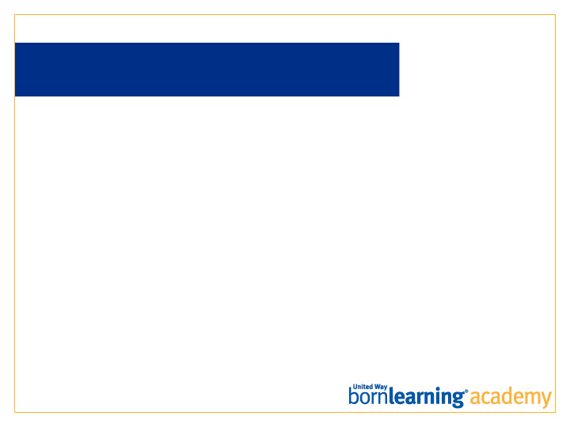
AT THE END OF THIS SESSION, PARTICIPANTS WILL BE ABLE TO:
Identify two ways learning can occur in every day routines.
Demonstrate two specific ways to help children learn on the go.

Slide 4
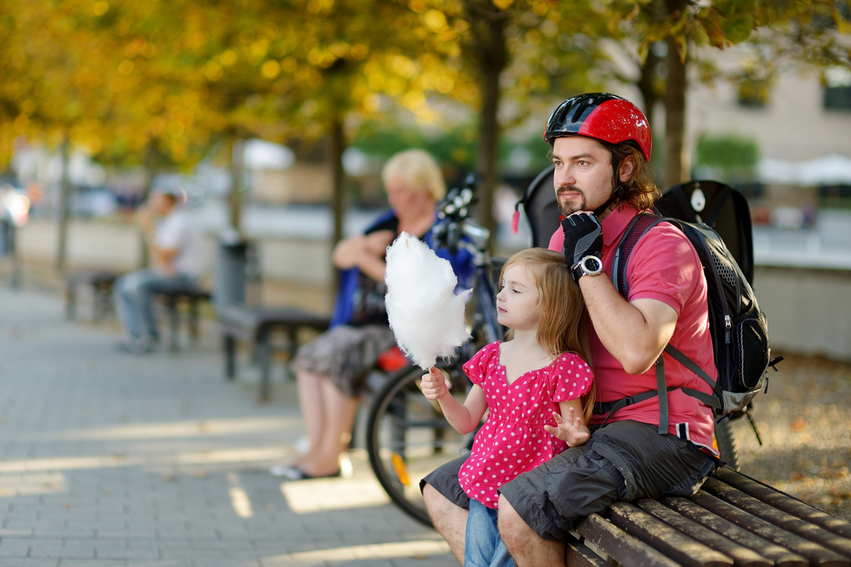
LEARNING OPPORTUNITIES
ARE EVERYWHERE
One of the great things about children and a key idea of Born Learning is that
learning happens all around us.
No special tools are needed!

Slide 5
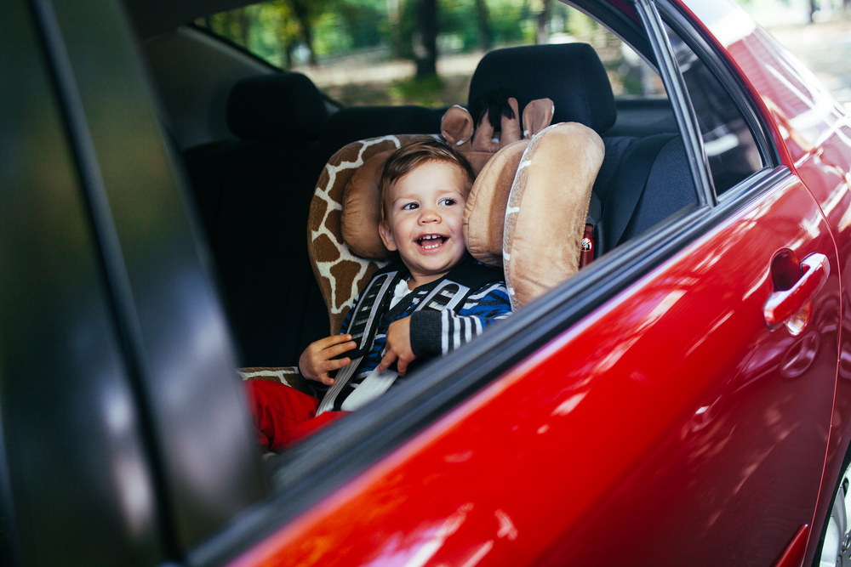
LEARNING ON THE GO
At home: Laundry, meal prep, bedtime.
Public places: Stores, parks, the library.
Traveling: In the car, bus, walking or biking.

Slide 6
REMEMBER
Moving from one activity to another can be a challenge for a child. Talk about what is coming next so children can know what to expect and develop communication skills.
Allow children to practice self-help skills.
Talk to children about what you are doing throughout the day.
Read the words all around you.
Children need time to explore, as well as consistent routines.

Slide 7
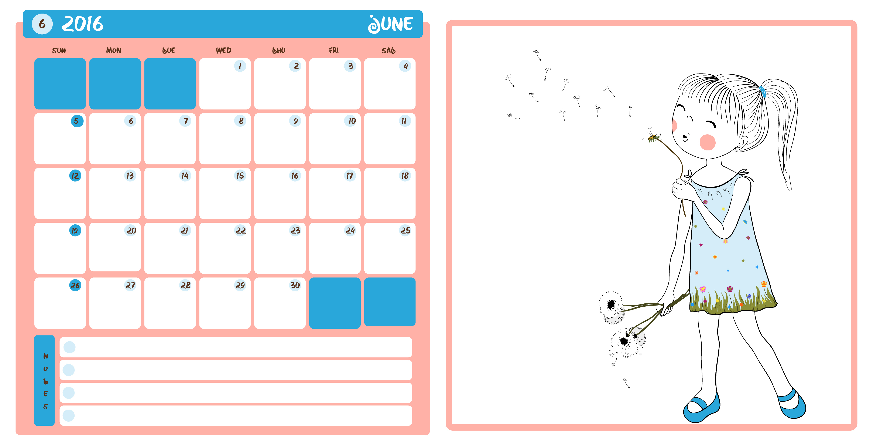
MORNING ROUTINES
The morning routine allows children to prepare for the day, learn about time and weather and practice self-help skills.
Use a calendar to help your child learn predictable activities.
Routine can teach organization/choices.
What are some opportunities to practice self-help and self care skills in the morning?
Allow children to be successful. Give them time to practice.

Slide 8
AFTER WORK/SCHOOL
Prepare children for the rest of the day. What’s coming next?
Talk to children while you are “on the go.” This builds vocabulary and your relationship.
Learn to “read” your child. What times of day/routine are the best for engaging them??
Allow time for rest.
Ask specific questions about your child’s day.
Involve children in things you are already doing such as table-setting or cooking.

Slide 9
BEDTIME
Remember the number of sleeping hours needed for your child’s age and plan ahead to allow for enough sleep.
Consistent routine helps with bedtime issues.
Avoid giving too many directions at once.
Model and help with self care skills such as tooth brushing and hand washing. You are your child’s best teacher.
Reading a bedtime story is calming. Be clear about the number of books you will read with your child.

Slide 10

HOMEWORK
Play “I Spy” with
your child when you are on-the-go.

Slide 11
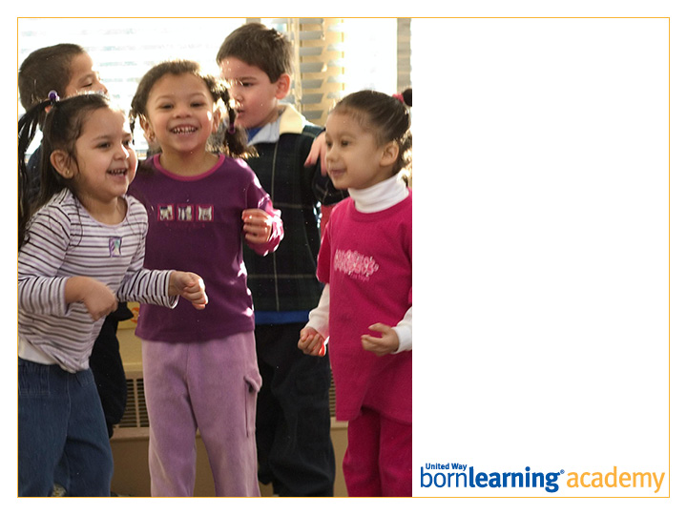
Post-Test

Slide 12
ACTIVITIES
Grocery on the Go
Laundry Sort
Setting the Table
Weather Wheel

Slide 13
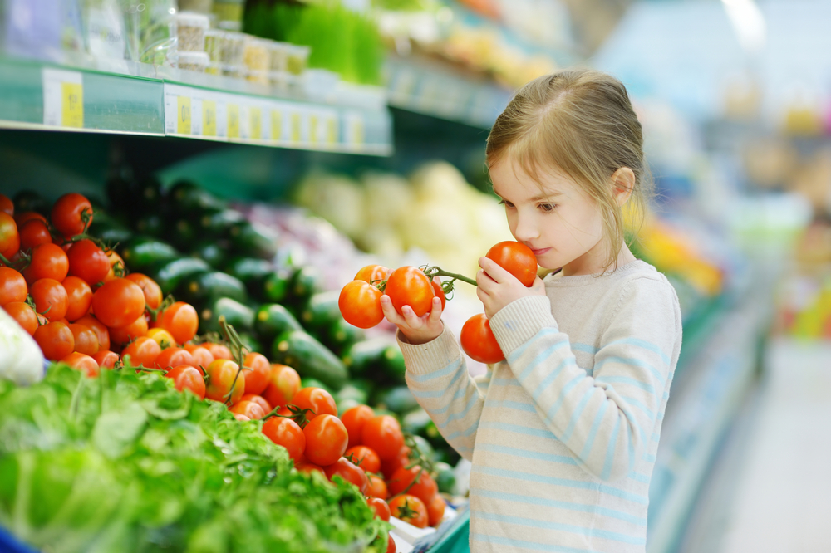
GROCERY ON THE GO
Let your child help you find things in your grocery store.
In one of tonight’s activities, your child will match up words/pictures of foods to the actual food items.

Slide 14
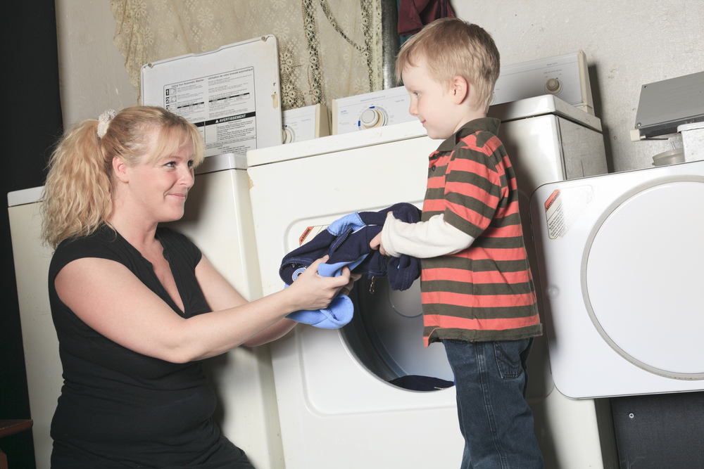
LAUNDRY SORT
Have your child make piles of the light and dark clothes. Children can also help by matching pairs of socks or sorting all of the shirts, pants and other clothes.
Feeling useful also helps children feel good, which encourages them to continue to want to be helpful.

Slide 15
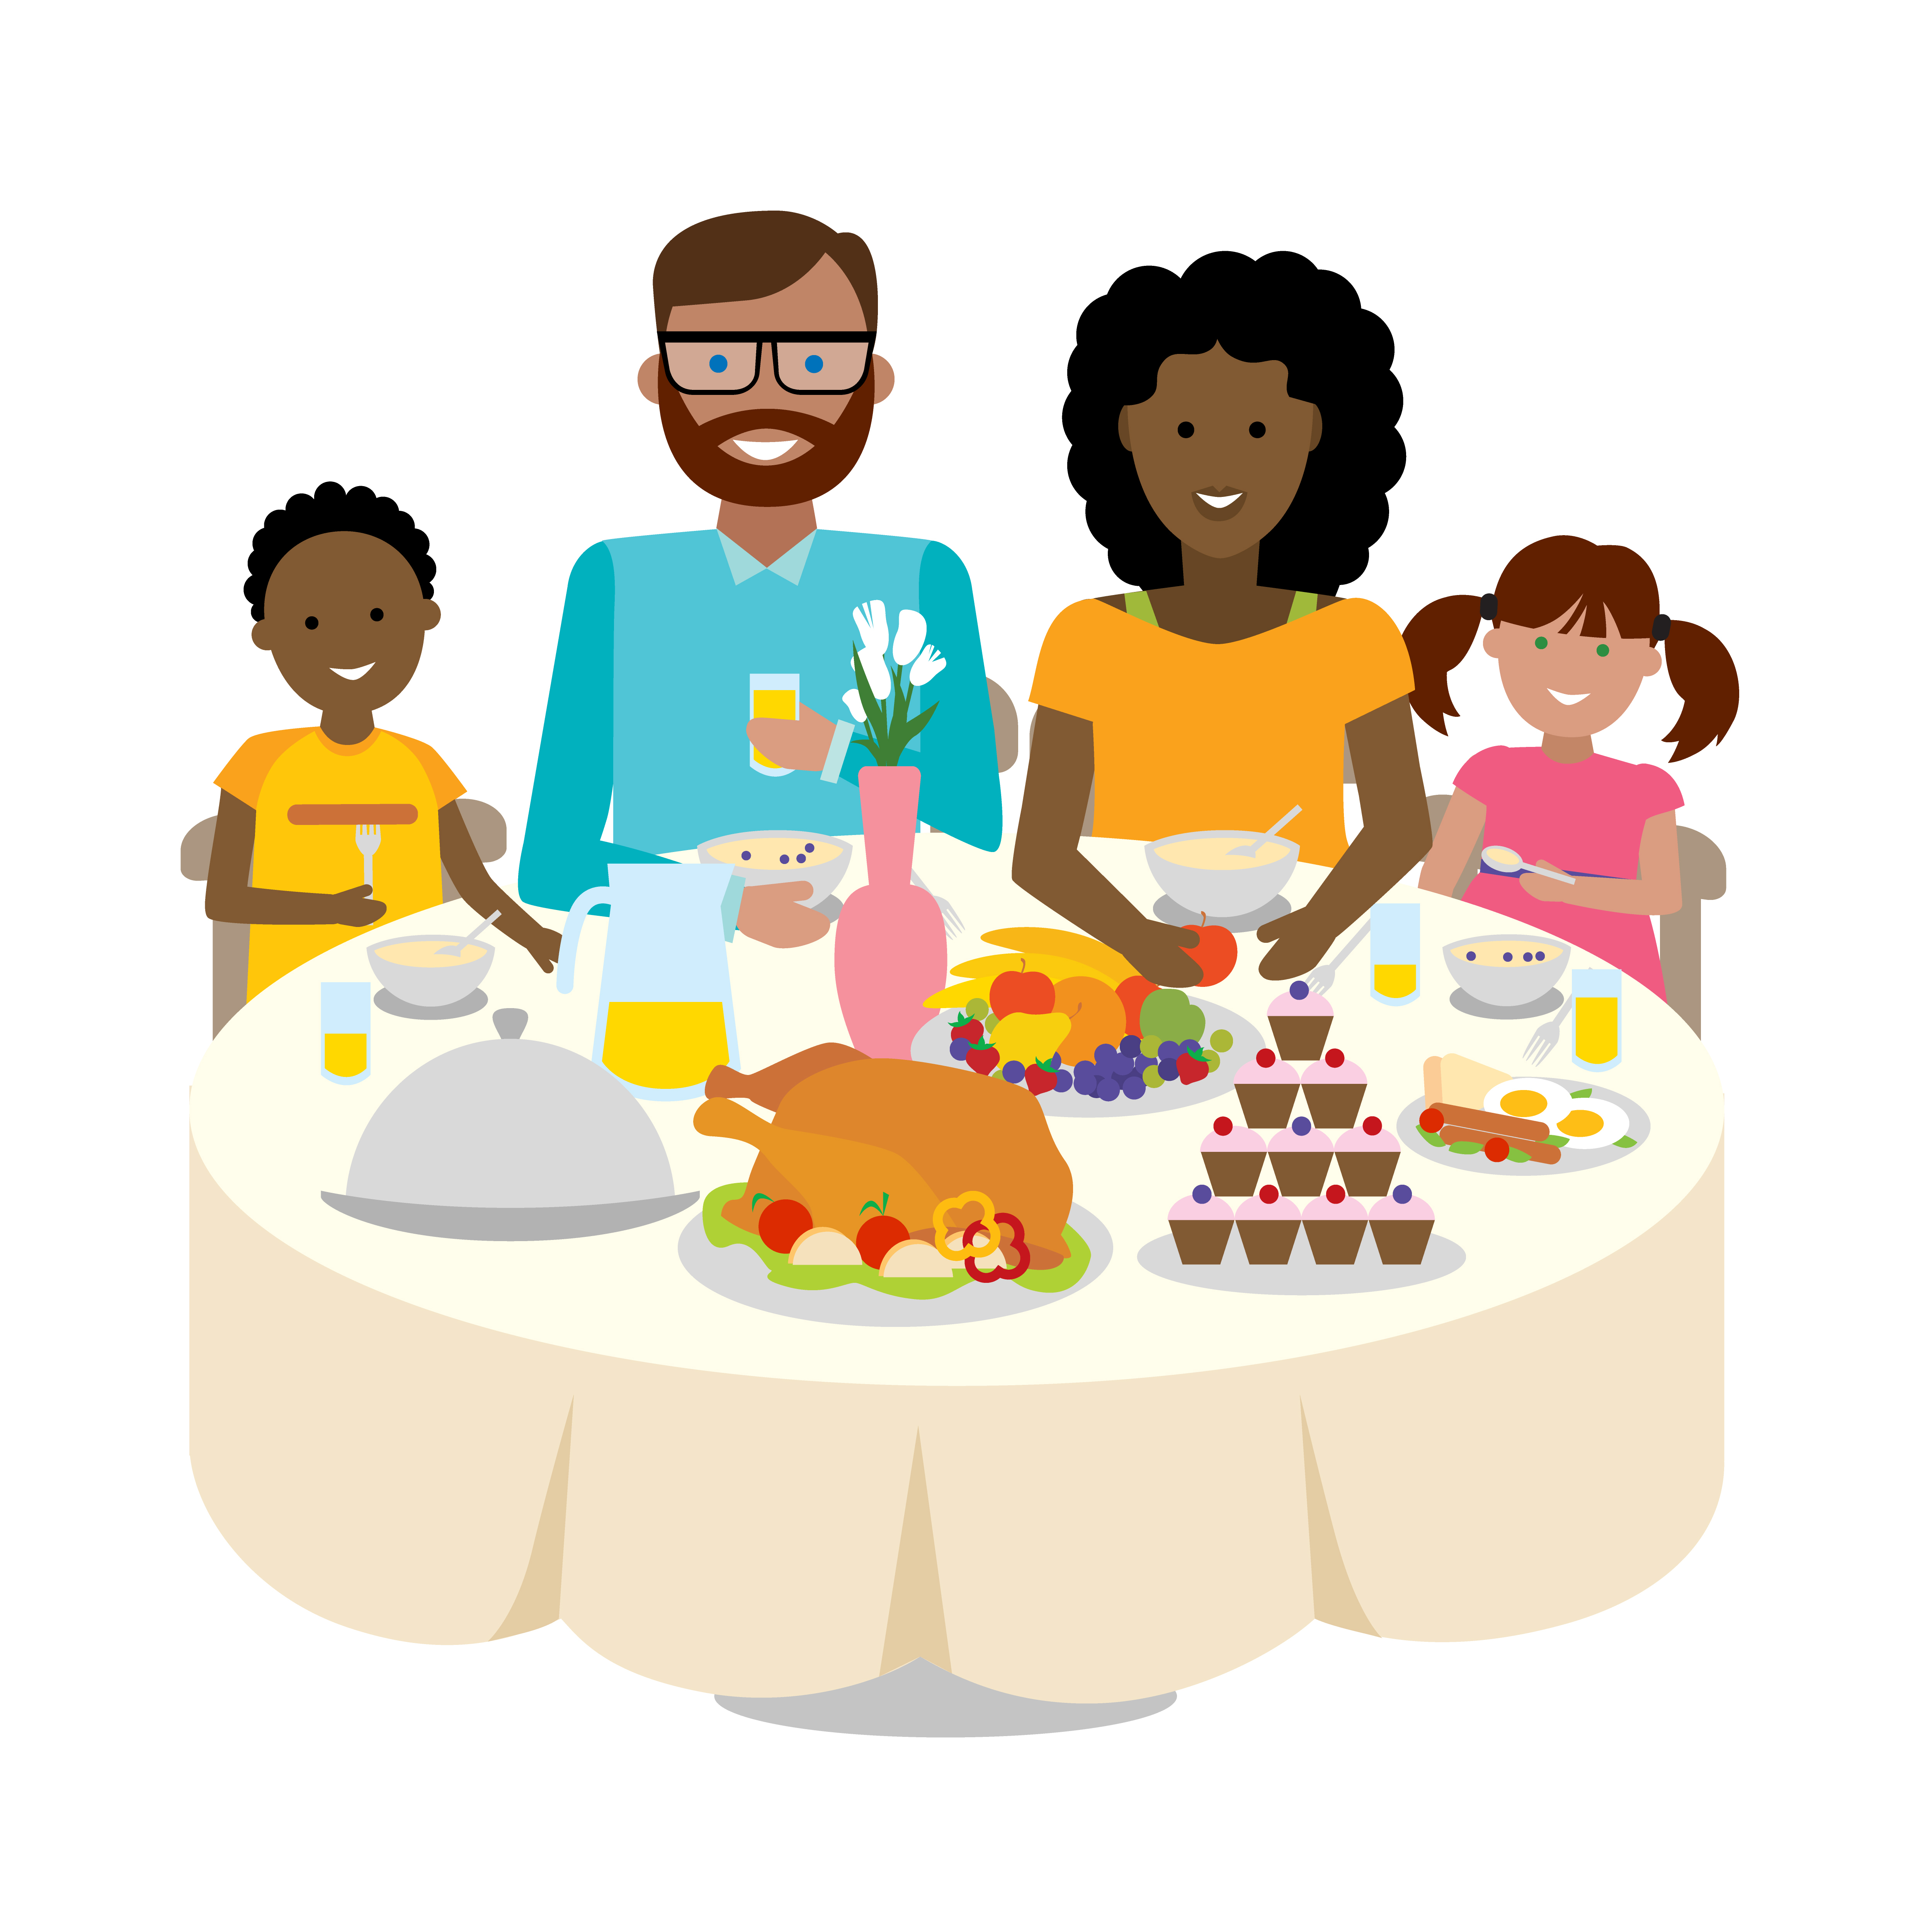
SETTING THE TABLE
Children can help set the table.

Slide 16

WEATHER WHEEL
Make a weather wheel to use every day as part of your morning routine.
Talk about what the weather is like for the day and how it affects things.
Ask, “what should you wear? What kind of activities can you do or not do?”

Slide 17
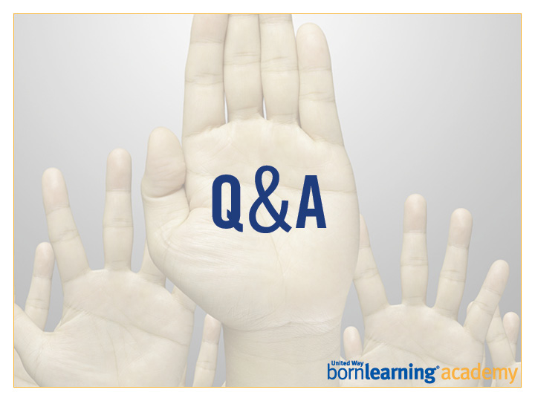

Slide 18
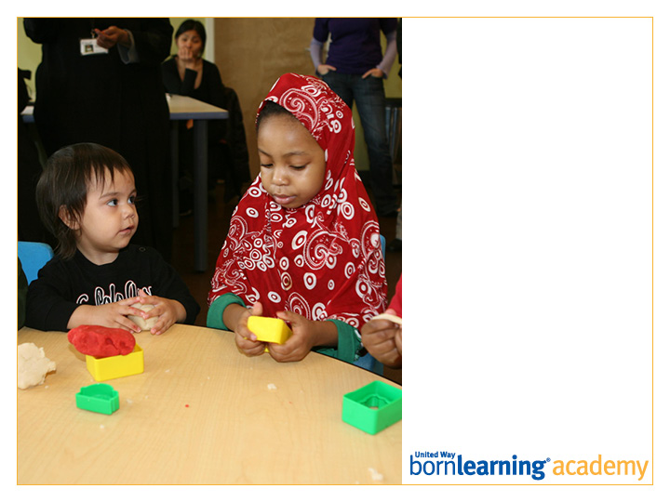
Thank you!
Graduation:
DATE AND TIME

Slide 19
SECTION HEADLINE
Deck style

Slide 20
SECTION HEADLINE
Deck style

Slide 21
SECTION HEADLINE
Deck style

Slide 22
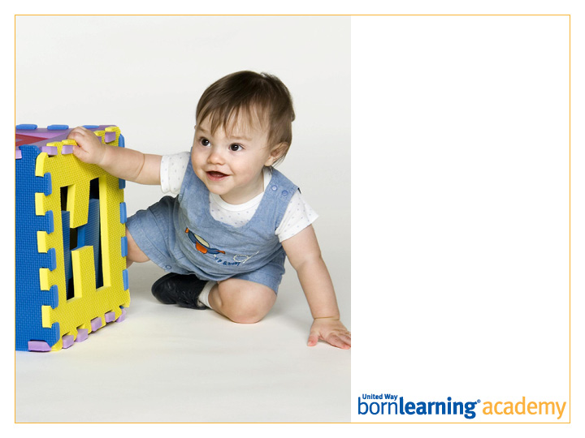
SECTION HEADLINE
Deck style

Slide 23
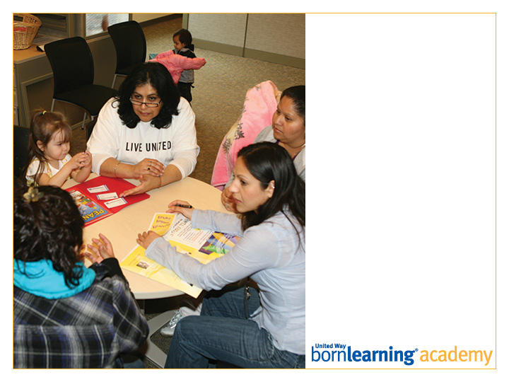
SECTION HEADLINE
Deck style

Slide 24
SLIDE TITLE GOES HERE
Bullet copy style
Bullet copy style
Bullet copy style
Bullet copy style

Slide 25

Open Copy/Layout Slide

